Slide 1

Data Structure
Level 1
Big O(n²) : Quadratic Time Function

Slide 2

Data Structure
Level 1
Complexity of an Algorithm
Big O
O(n²)
2

Slide 3
Data Structure
Level 1
Quick Review
2

Slide 4
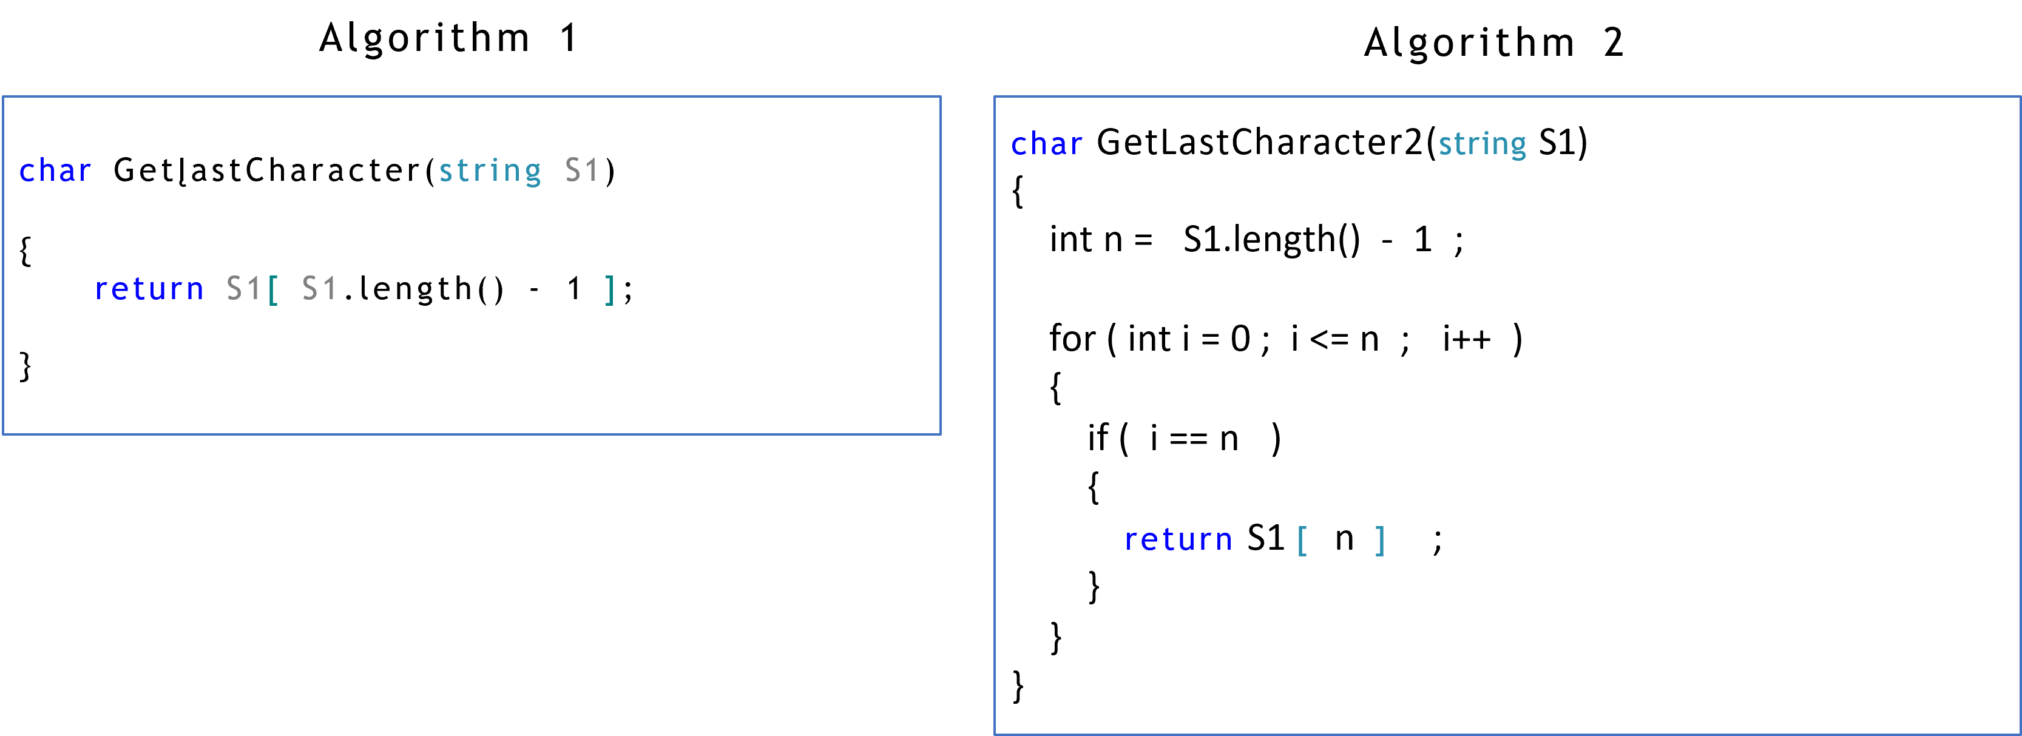
Big O for the following Algorithms:
O(1)
O(n)

Slide 5
Data Structure
Level 1
Calculating Algorithm Complexity
O(n²)
2

Slide 6
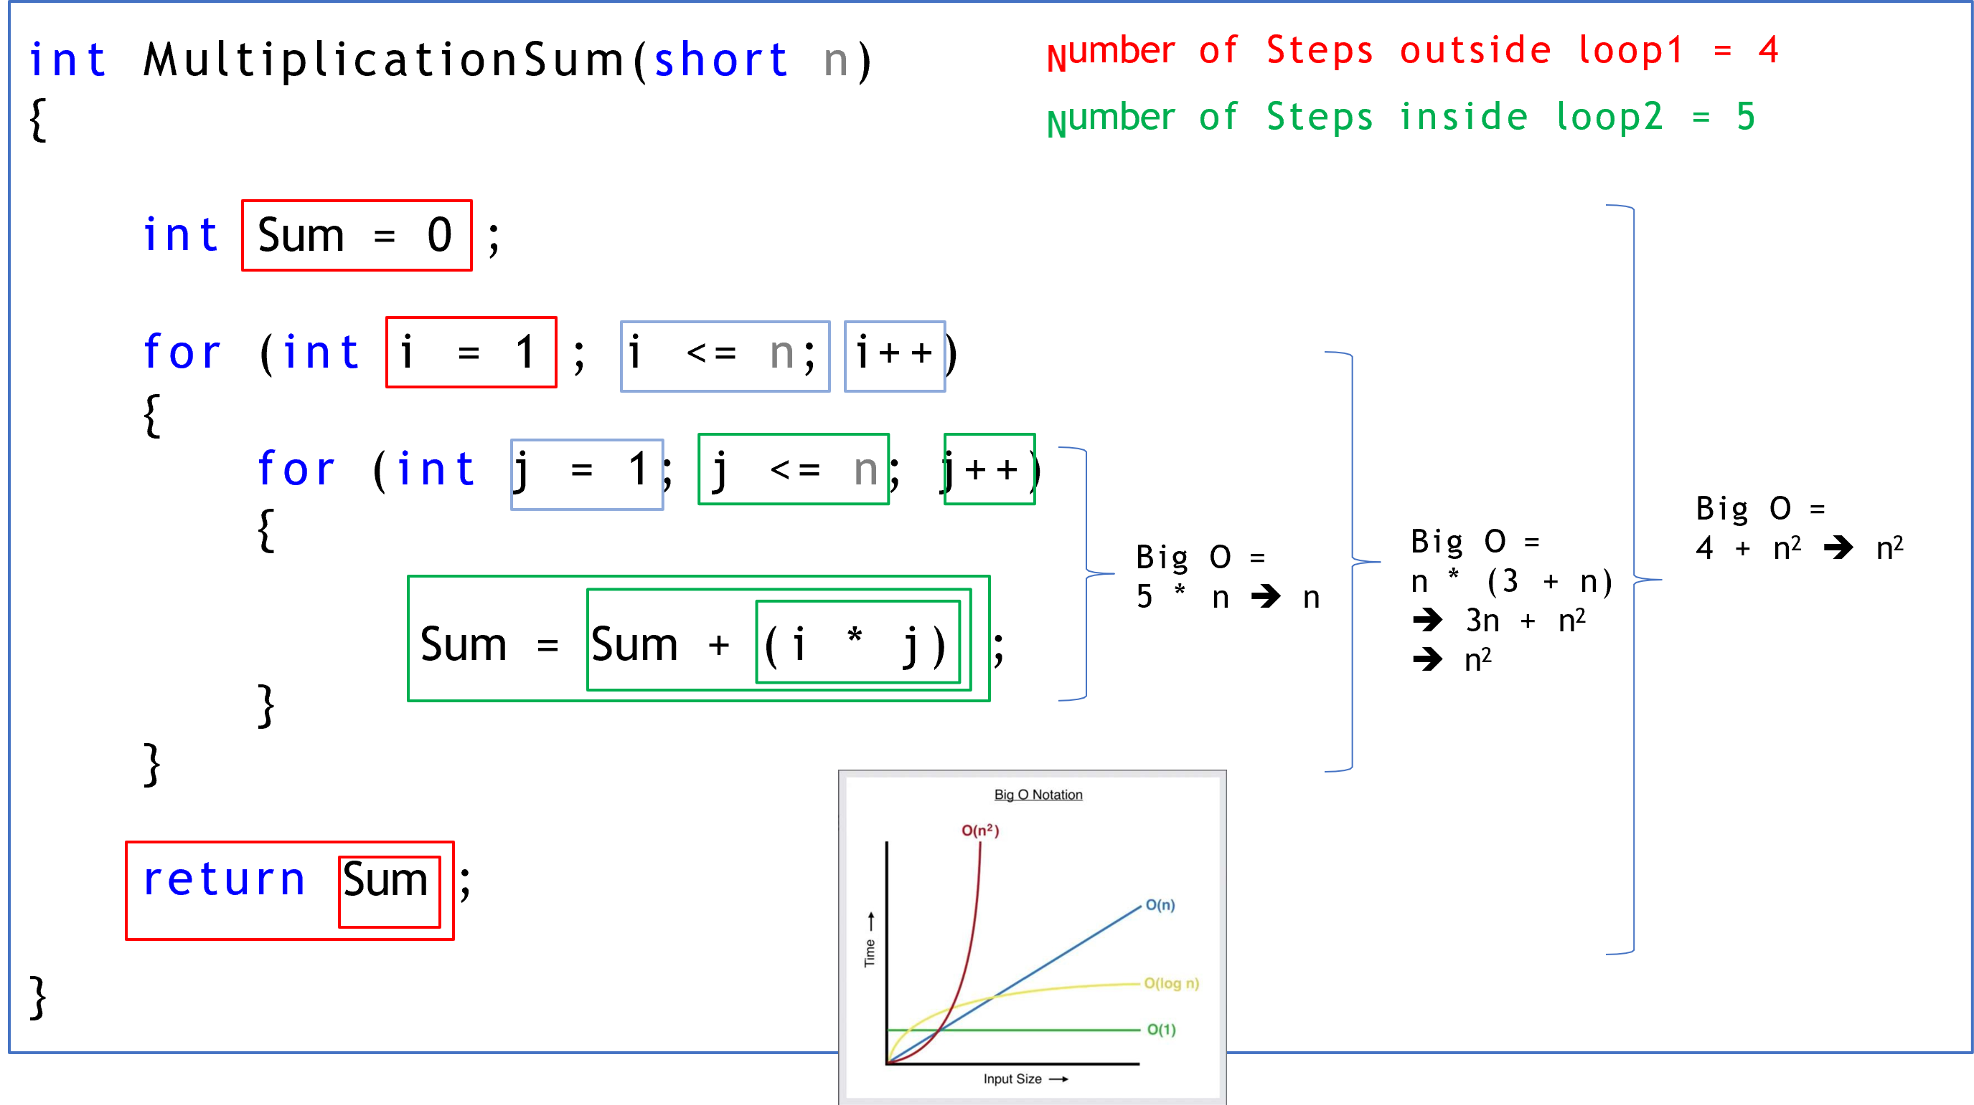
Calculating Algorithm Complexity:
Depends on n size, and relation is Quadratic Time Function.

Slide 7
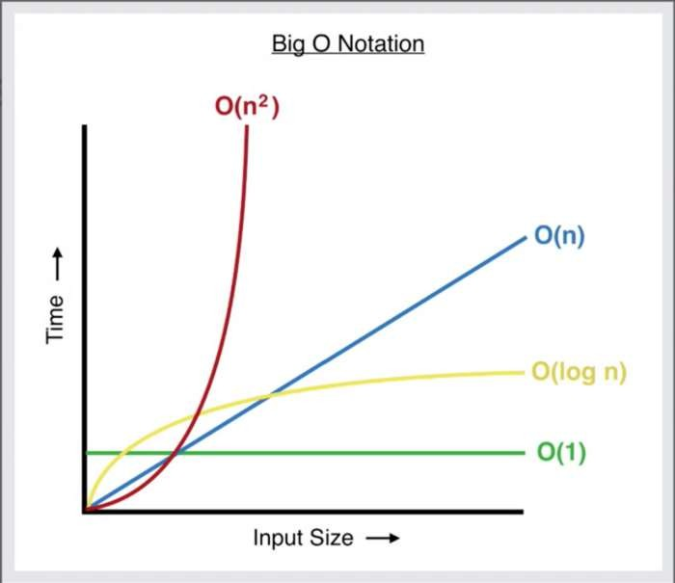
Whích is faster?

Slide 8
Thank you ☺

